Slide 1
Using Summary Scatterplot Reports to Empower District Instructional Discourse and Reform
By Timothy Johnson

Slide 2
Vehicle Health Reports Summary

Slide 3
Vehicle Health Reports

Slide 4
NYS Scatterplots – Public Data https://dataview.wnyric.org/PublicData/ReportCards
Notes:
You can. Here is an example of a scatterplot. The link is public. You don’t need a login. You fill in what you want from the pull down menu. There are many versions of scatterplots you can produce. That is why they can be very effective tools to start discussions. There are other types of scatterplots that display data in this manner.

Slide 5
Another good source for scatterplots
Cornell University
http://www.nyeducationdata.org/

Slide 6
What types of Assessment Health Reports can be Created?
Notes:
I like using snips of scatterplots to create summary reports to promote discussions. To do this takes a little work because you have to produce a report and then snip it. I’m going to show you how I created the Canandaigua slide. Now that you know how to do it, the fun can start.

Slide 7
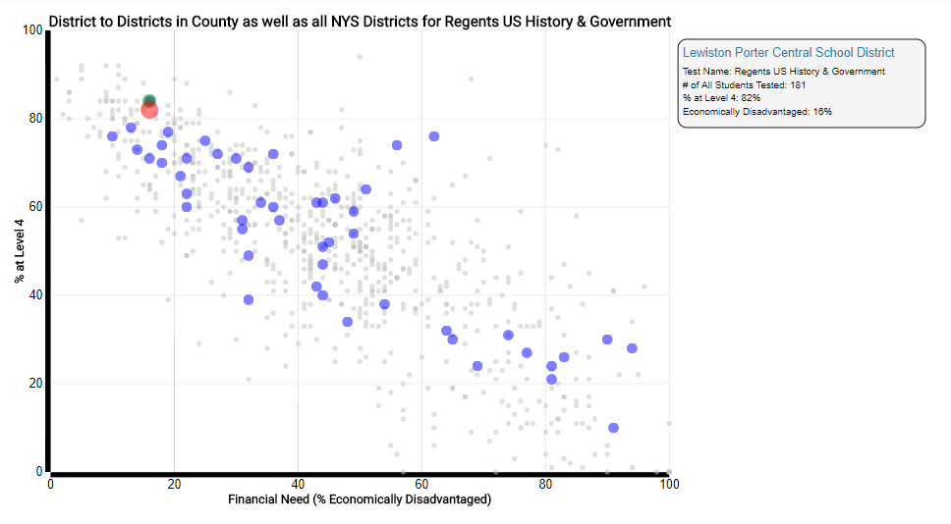
What if I pulled all the scatterplots for a Subject?
Notes:
What if I pulled all the scatterplots for a subject? Here is a Regents Social Studies example. What does the first plot tell me? I pulled one of my districts in Niagara County. What comments & questions might you have after seeing these plots? What can you tell about the district?

Slide 8
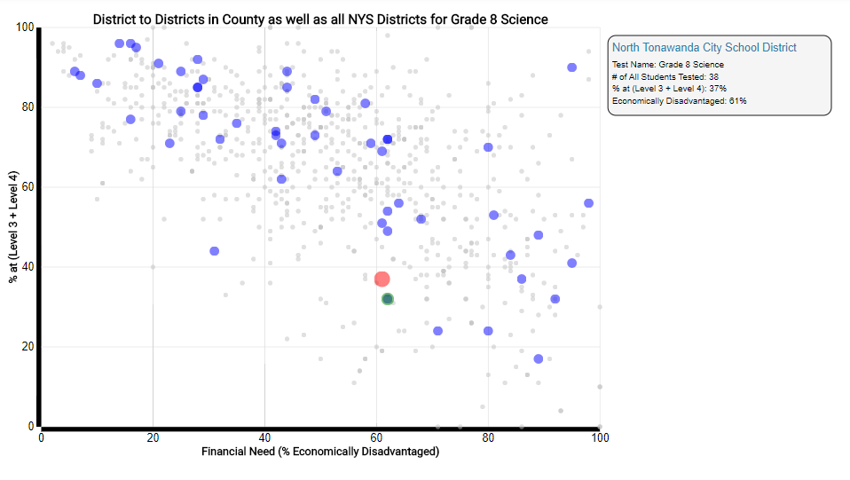
Here’s one for 4 & 8 Science
Notes:
Here is one for 4 & 8 Science. Again what can I glean from the charts? Why is there such a disparity between the 4th grade cohort tested (153) and the 8th grade cohort tested (38)?

Slide 9
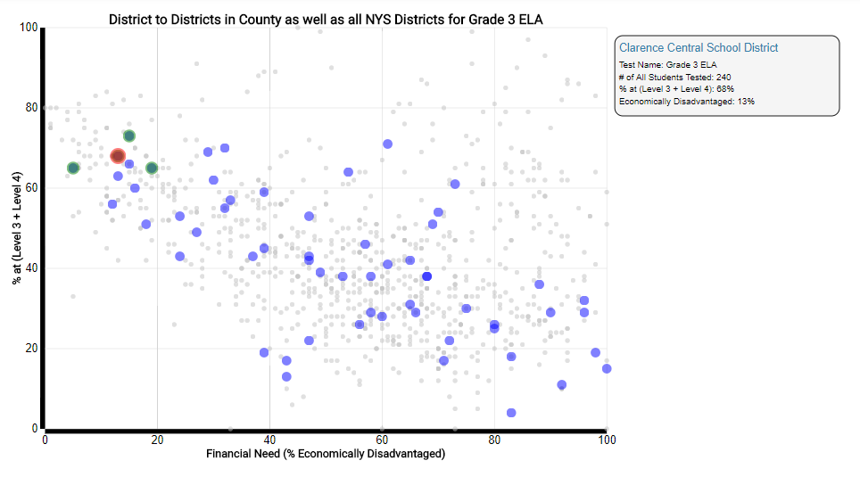
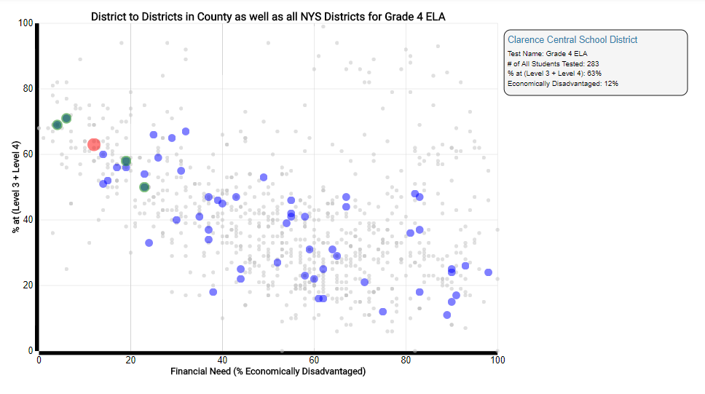
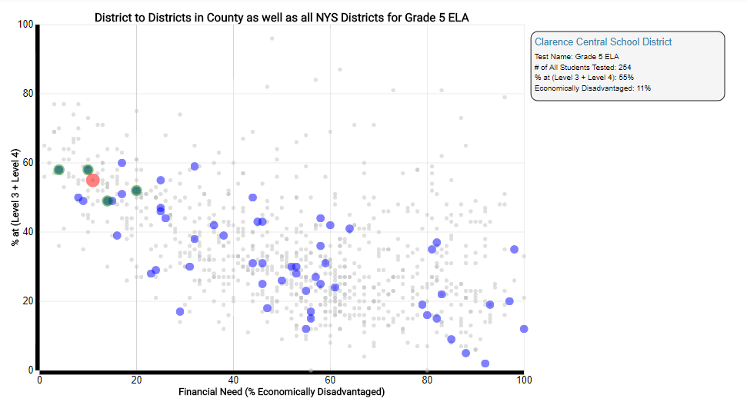
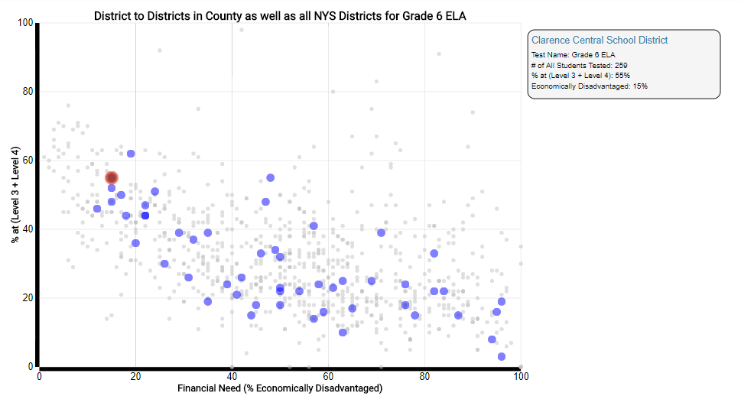
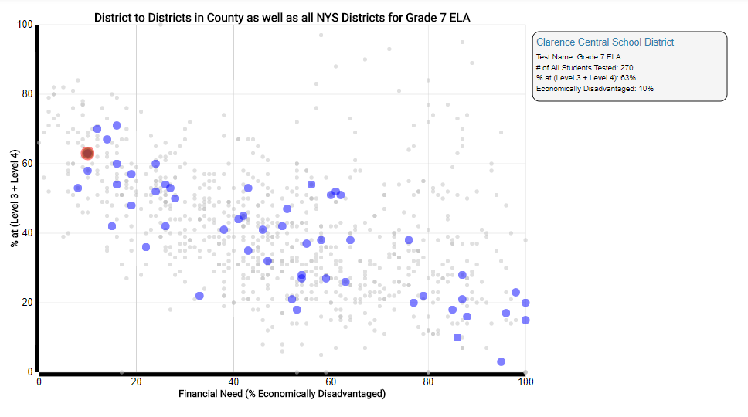
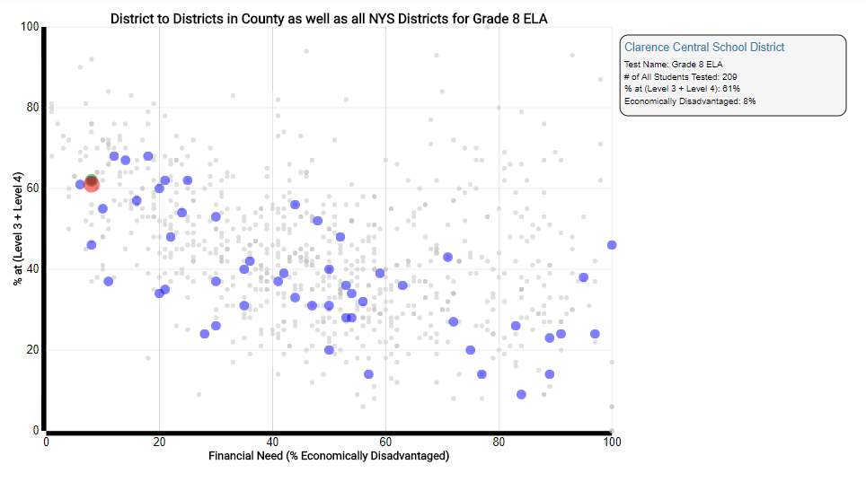
3 – 8 English Language Arts
Notes:
Here is a 3-8 ELA example. What questions might you have after looking at this data? What are the green dots? How many students are in a cohort? 3rd -240/4th – 283/5th -254/6th -259/7th – 270/8th - 209

Slide 10
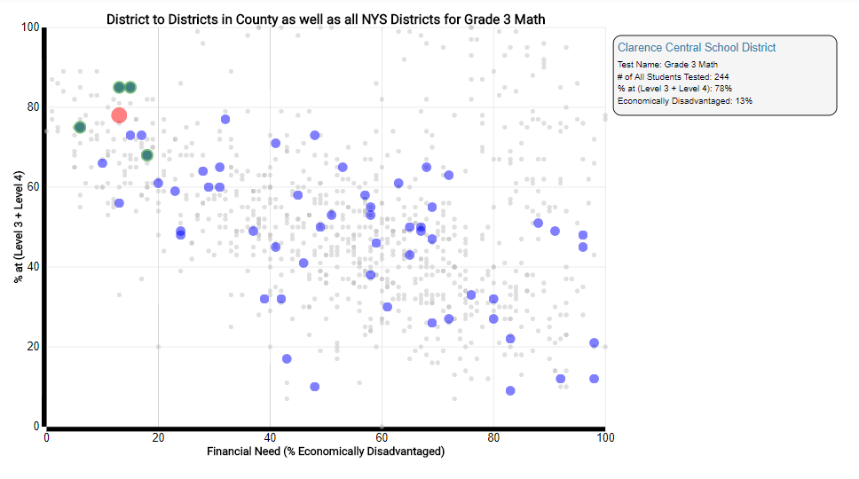
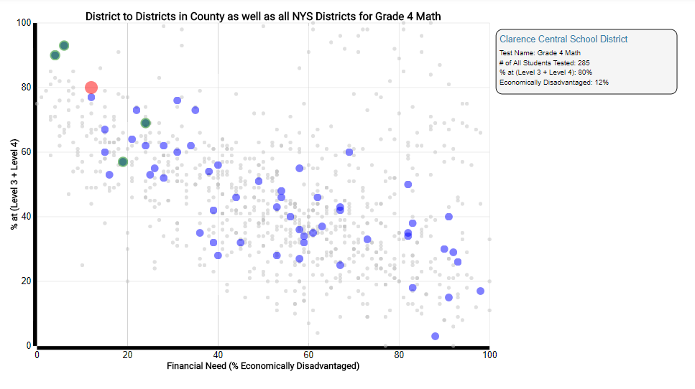
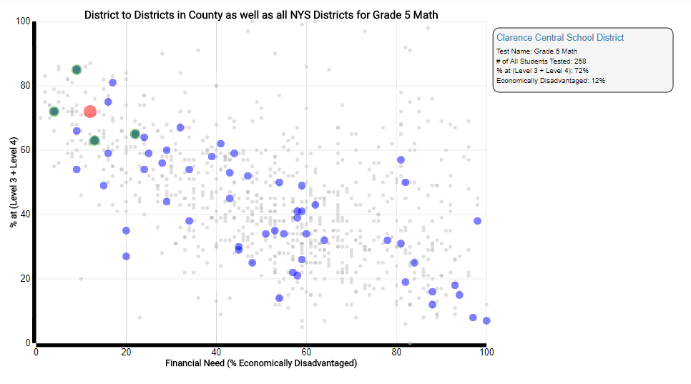
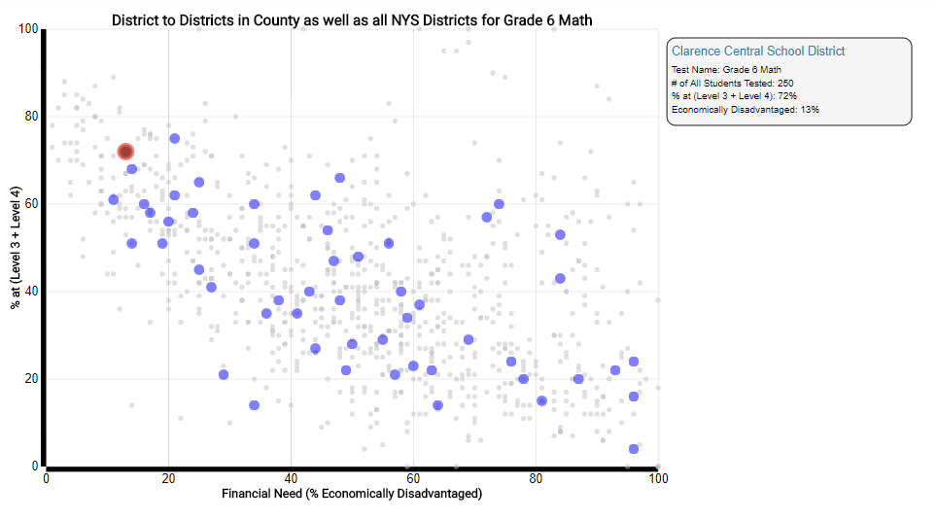
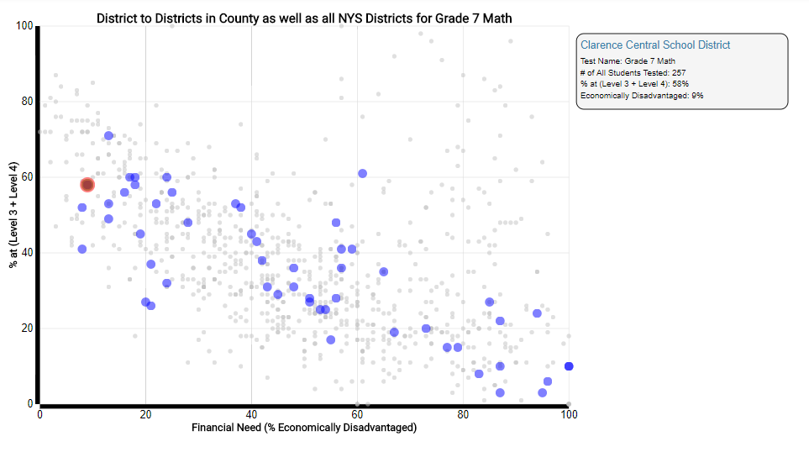
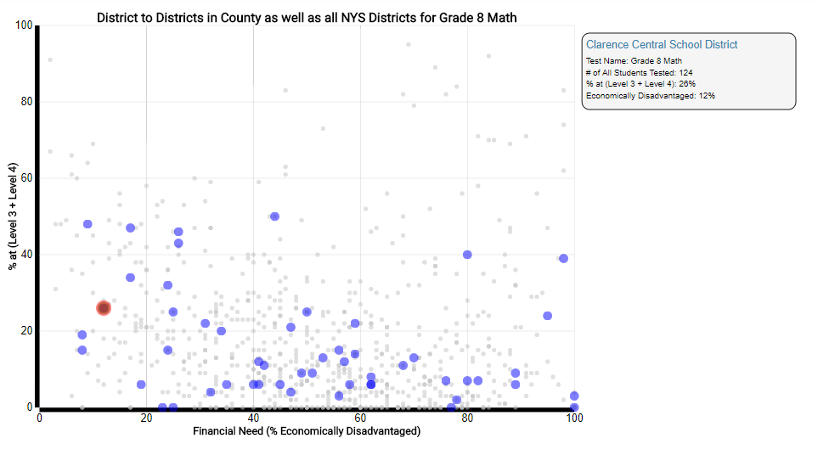
3 – 8 Mathematics
Notes:
What happens if I look at the Math for the same group? Why is this valuable? What happened to 8th grade? 3rd -244/4th – 285/5th -258/6th -250/7th – 257/8th - 124

Slide 11
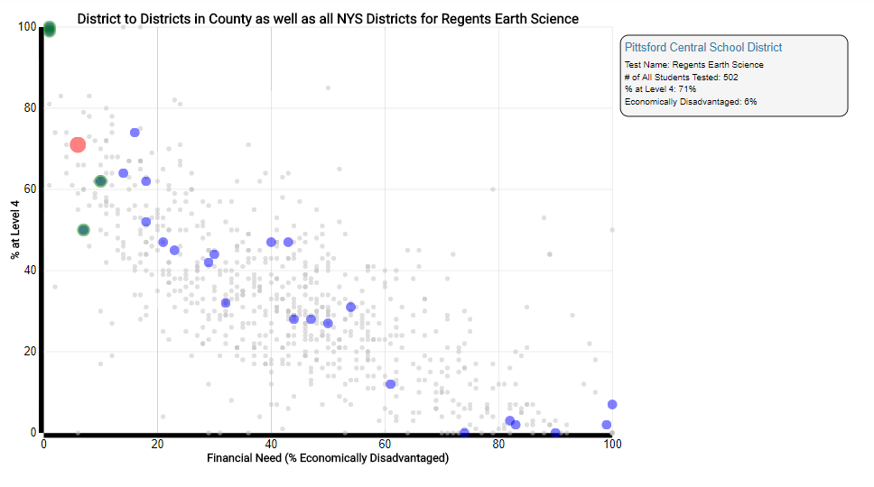
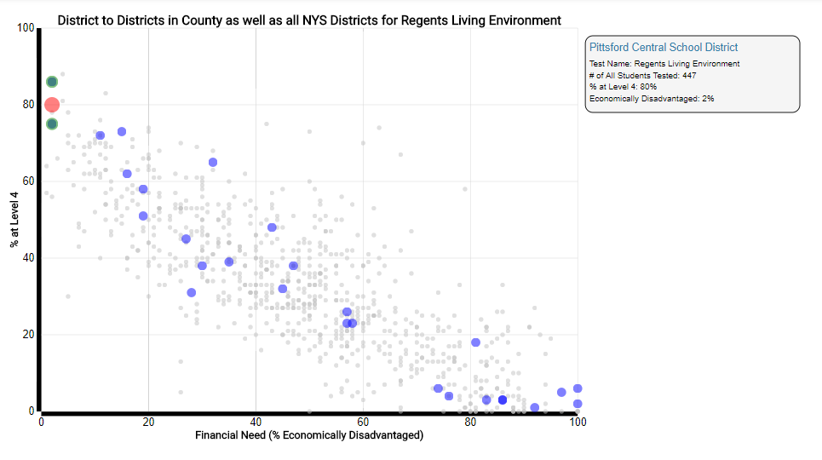
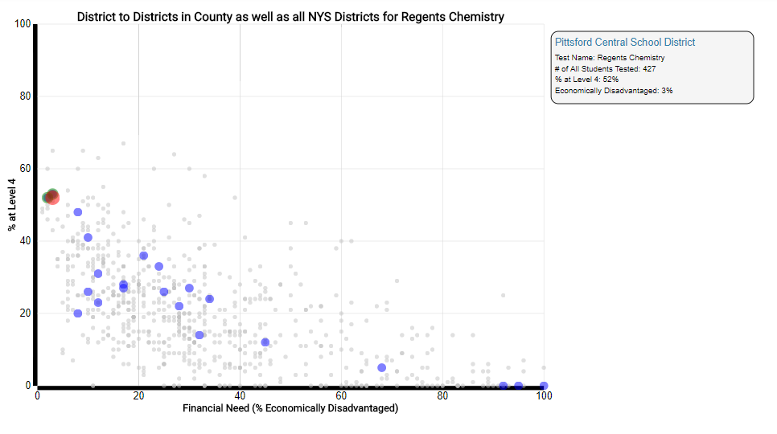
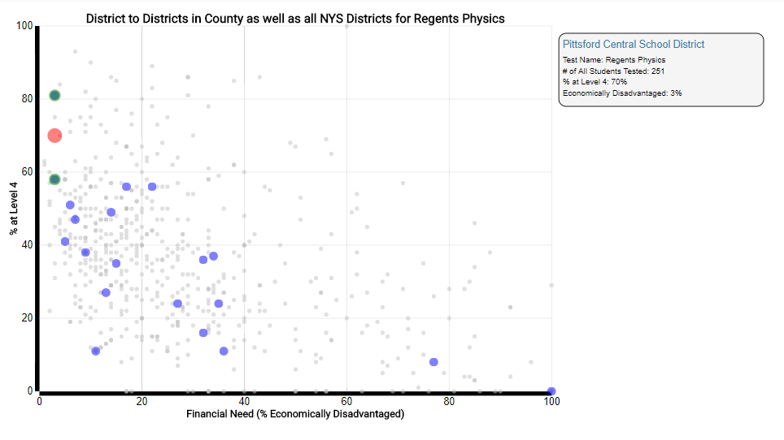
Regents Science
Notes:
Lets look at a secondary science example. What would you say about this data? Earth Science – 502/Living Environment – 447/Chemistry – 427/Physics - 251

Slide 12
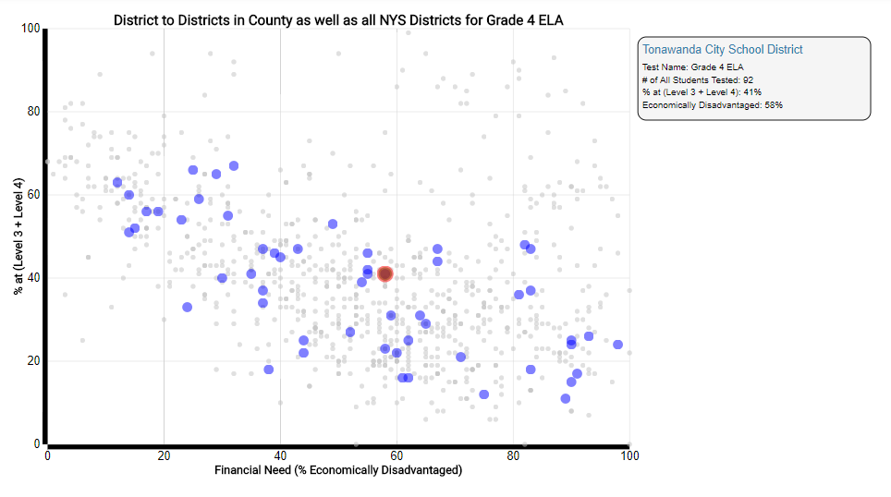
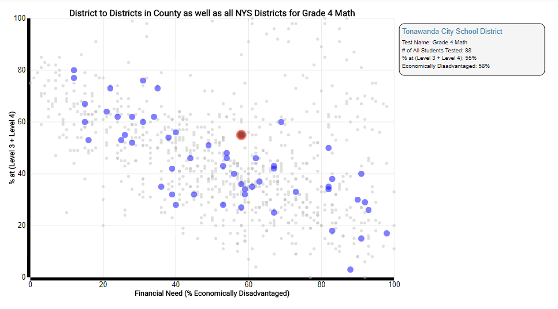
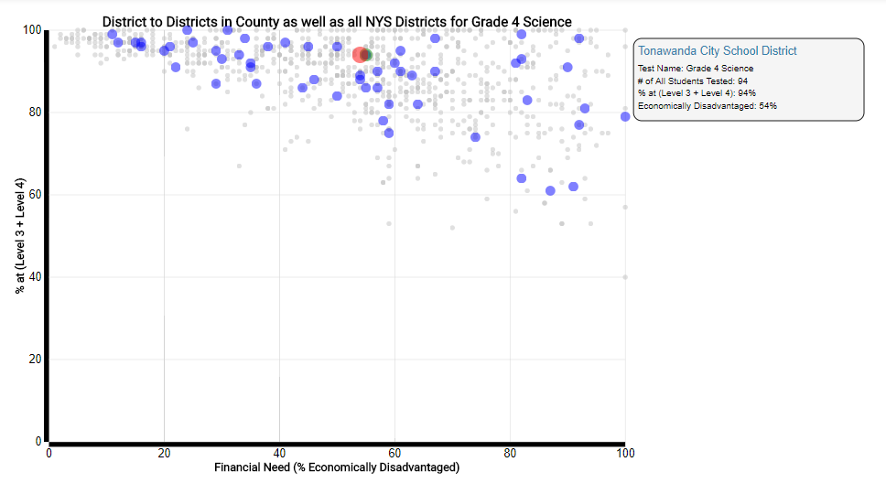
Pull all the Assessments by Grade. This one is Grade 4 ELA – Math - Science
Notes:
Here is an example of pulling the data by cohort group. These are 4th grade students in ELA, Math, and Science. What do you notice about the group size. ELA – 92/Math – 88/Science - 94

Slide 13
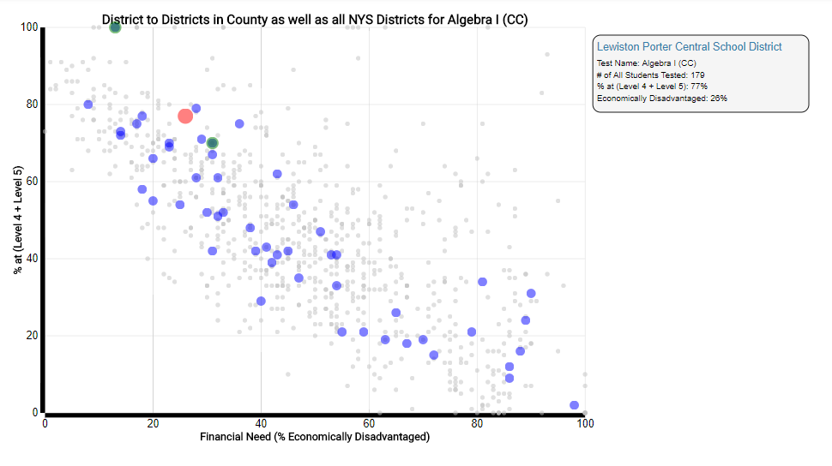
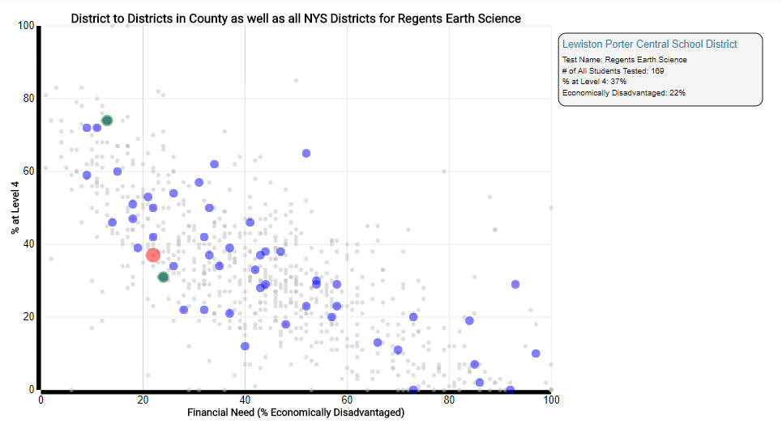
8th & 9th grade performance in Regents Algebra I CC and Regents Earth Science.
Notes:
You can do the same thing with secondary cohorts. The nice thing with secondary is you do not get the opt-outs. The green dots show the performance for the MS vs. the HS. Note that the MS performance is always higher than the HS. Algebra I – 179/Earth Science - 169

Slide 14
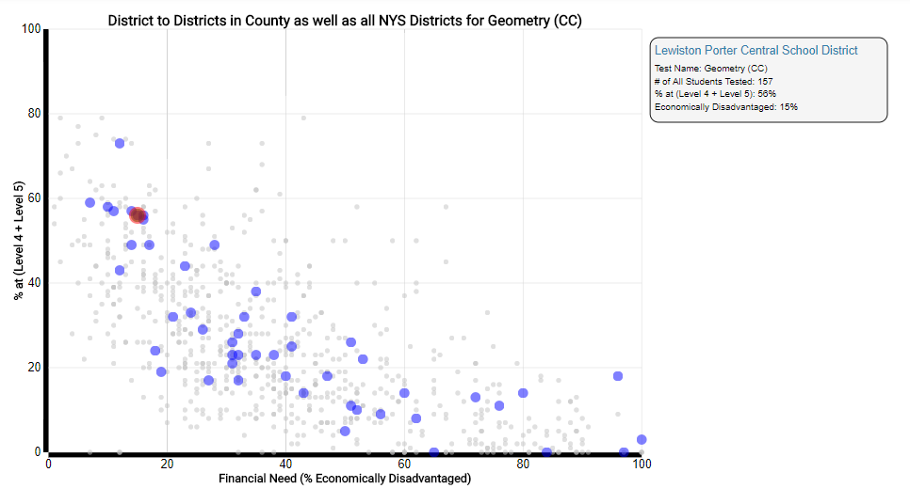
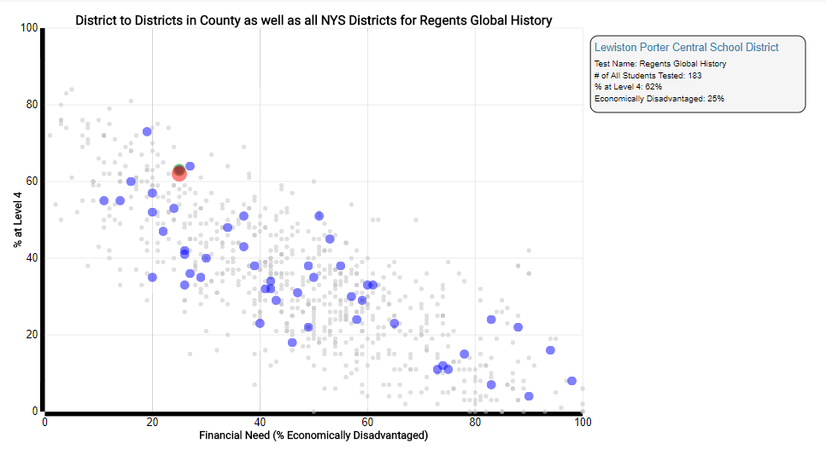
10th grade performance in Regents Geometry CC and Regents Global History
Notes:
This one compares 10th grade students. Why is the Geometry group so much less than the Global? Geometry – 157/Global – 183. Maybe there are secondary opt-outs!

Slide 15
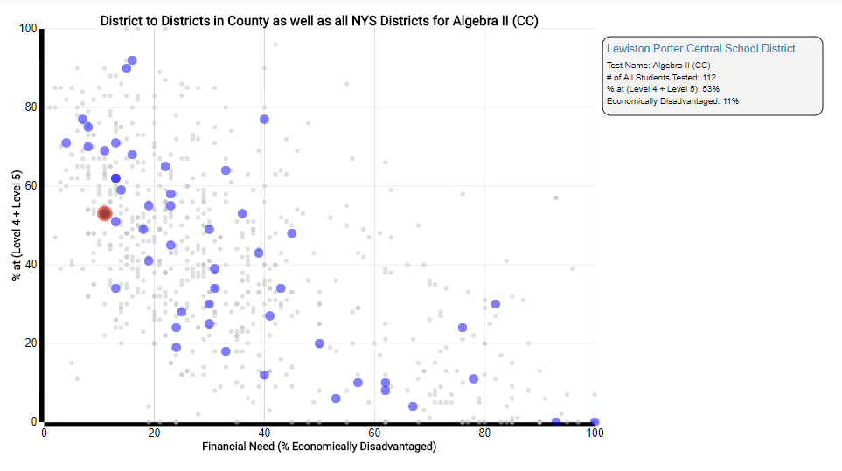
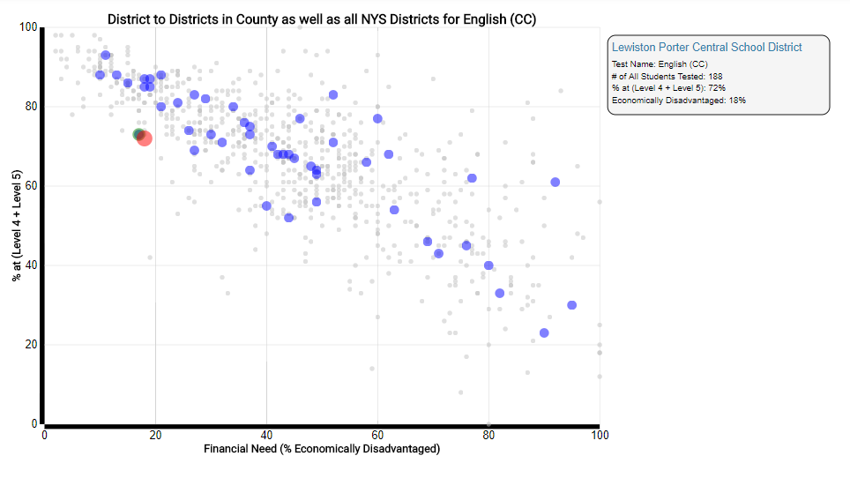
11th grade performance in Regents Algebra II, Regents US History and English CC.
Notes:
Here is a 11th grade example. Again why are the numbers different? What is one question you might have about these results? Algebra II – 112/US History – 181/English CC - 188

Slide 16
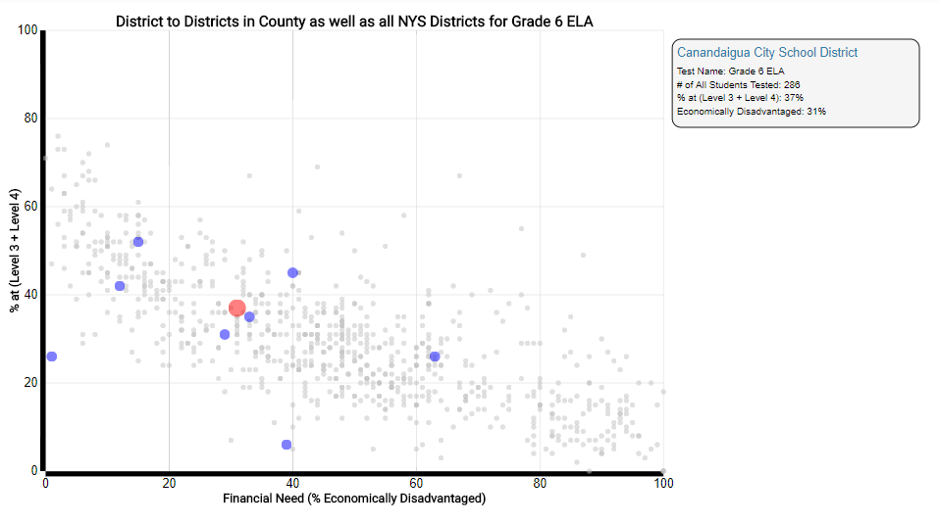
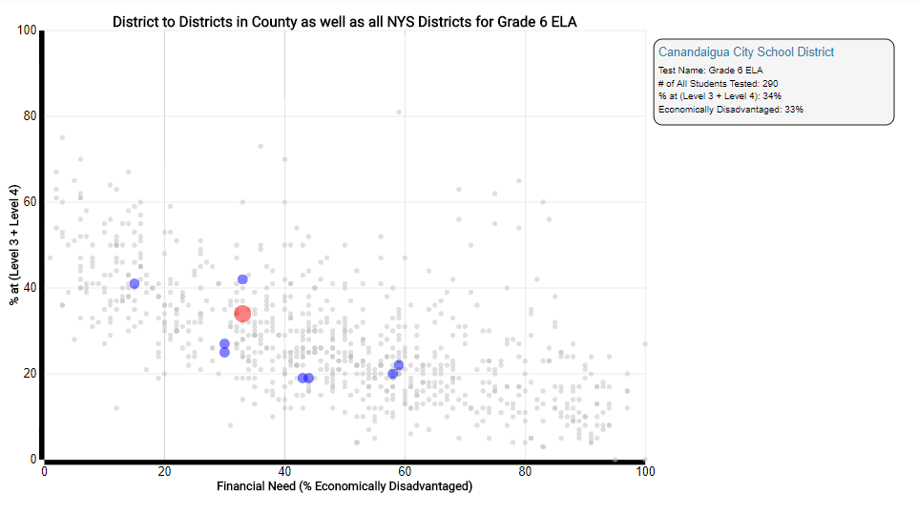
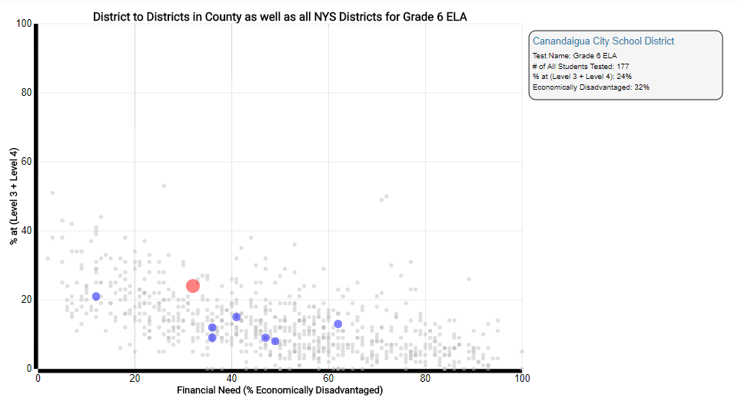
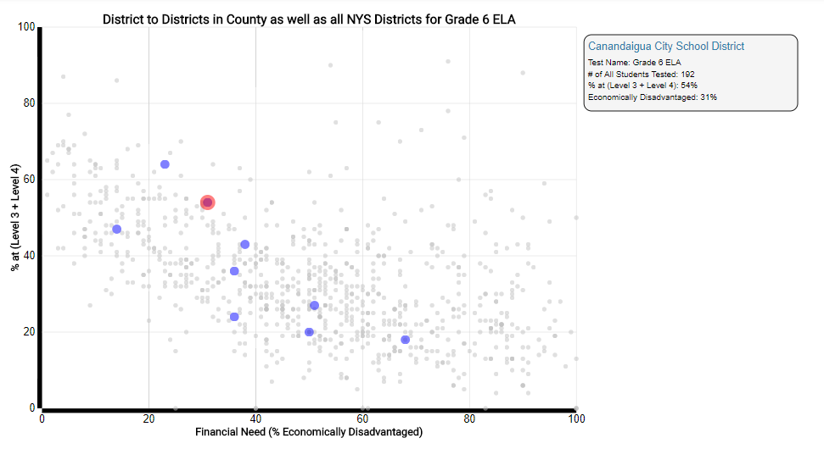
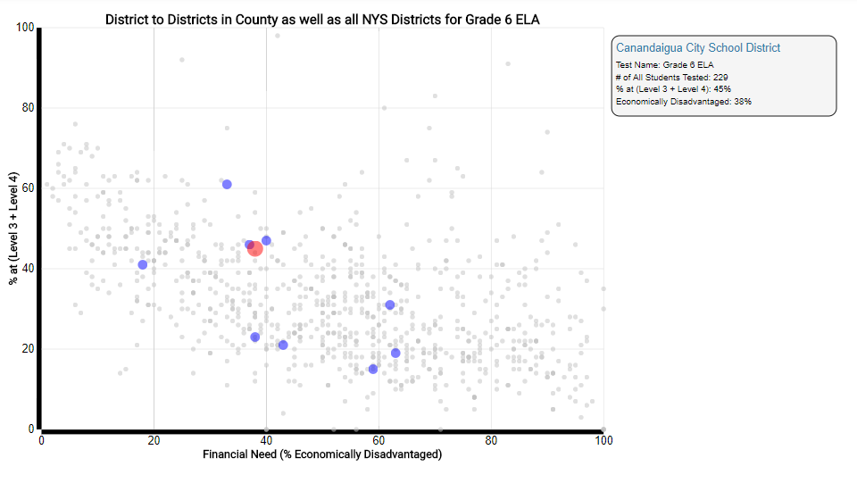
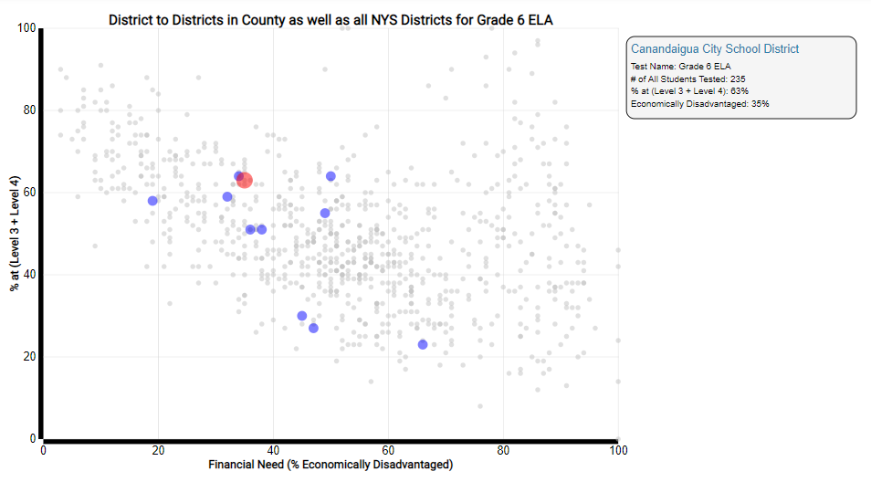
Here is a trend map of Grade 6 ELA from 2013 to 2018.
Notes:
Back to Canandaigua. Here is a 6th grade ELA trend map. What questions does this set of plots generate? Again, what is the cohort number indicating as you move through the years? 2013 – 288/2014 -290/2015 – 177/2016 – 192/2017 – 229/2018 -235/.

Slide 17
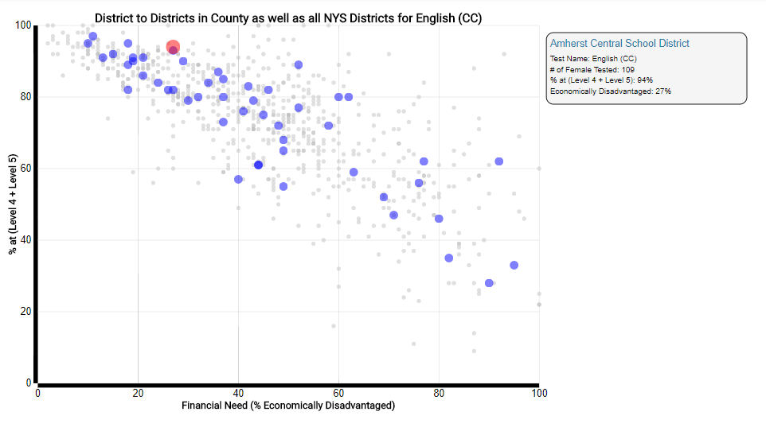
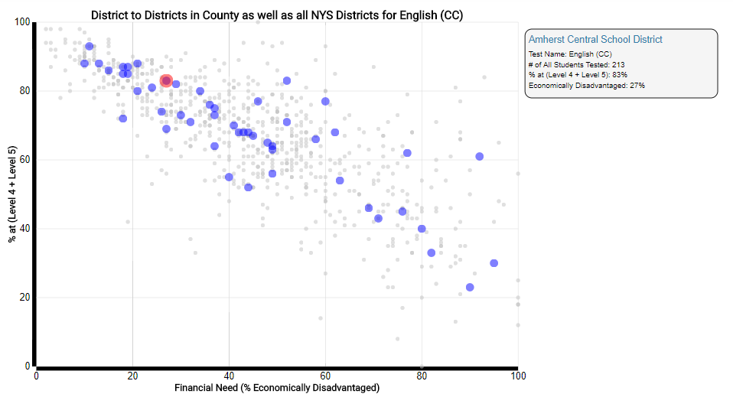
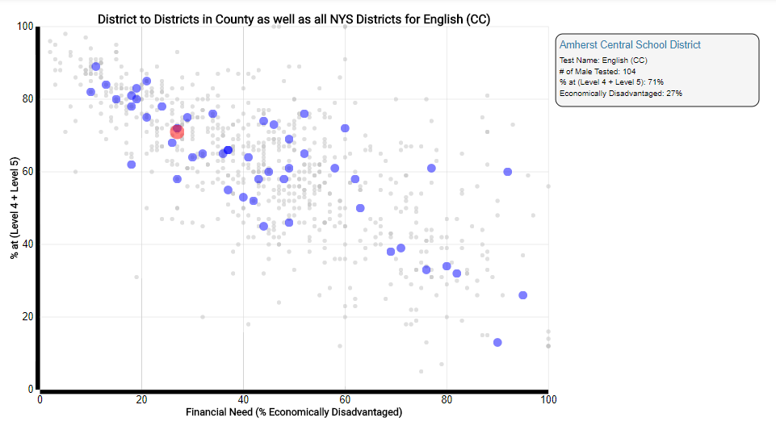
Here is a Gender Subgroup Example.
Regents ELA CC 2016-2017
Notes:
This next one is a little different. Gender is a NCLB subgroup that is under-utilized because schools are not technically held accountable. Why are the girls out performing the boys. Look at the overall state performance. A little shocking that the boys are trending lower. My next slide shows the same group in math. All – 213/Females – 109/Males – 104. Do I have any predictions?

Slide 18
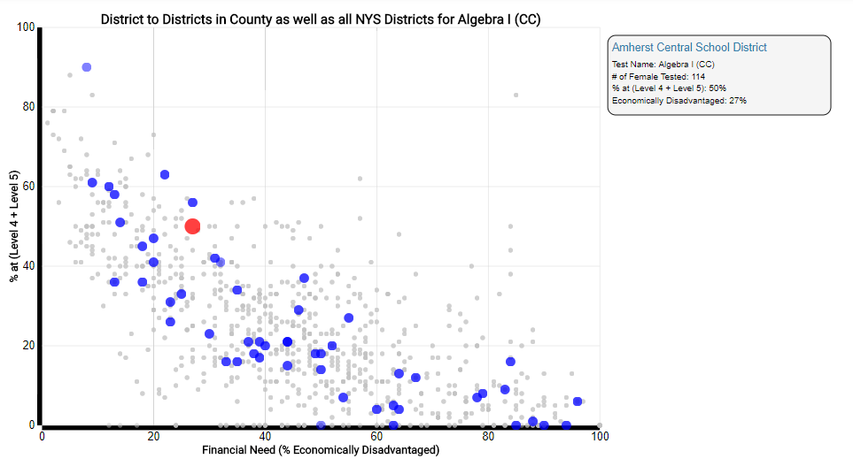
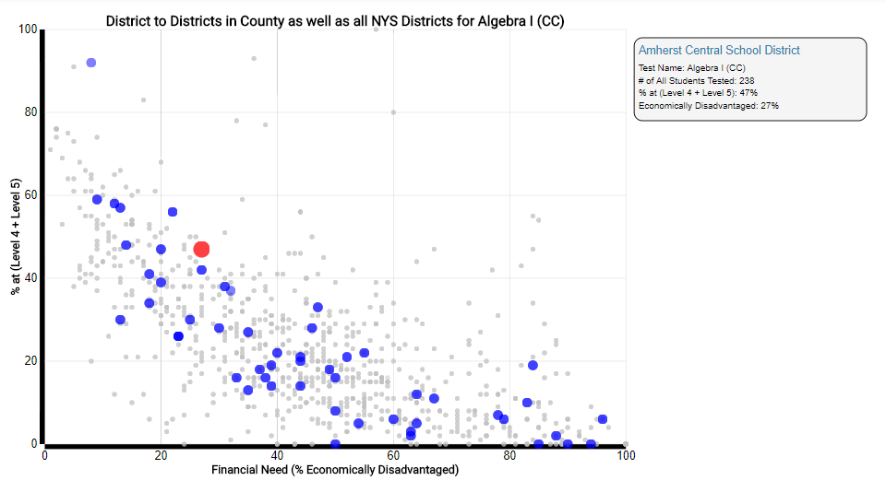
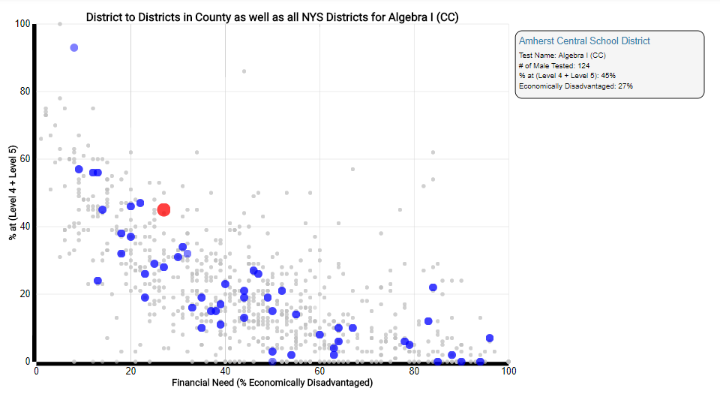
Here is the same cohort with Math.
Regents Algebra I CC 2016-2017.
Notes:
In Math the three plots are more similar although there is still a slight disparity. All – 238/ Females – 114/ Males – 124.

Slide 19
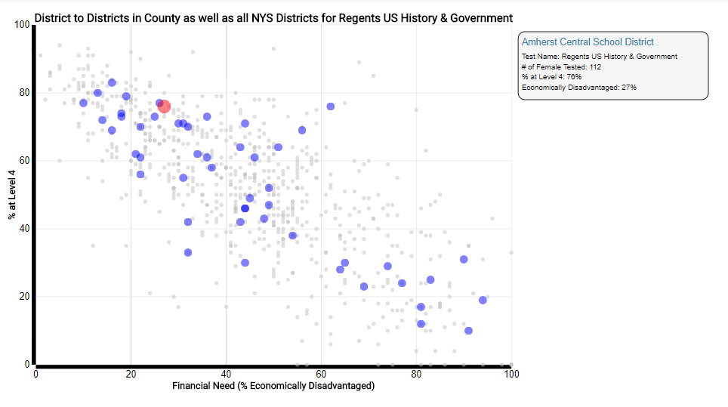
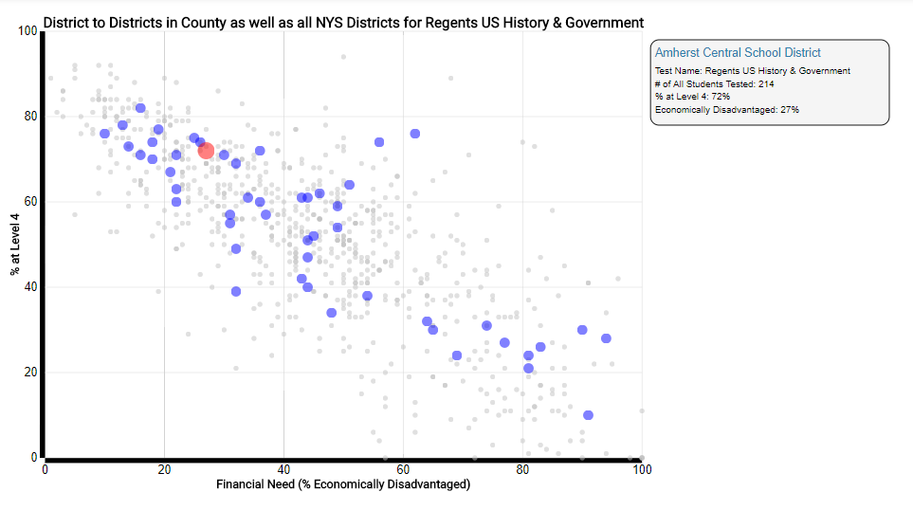
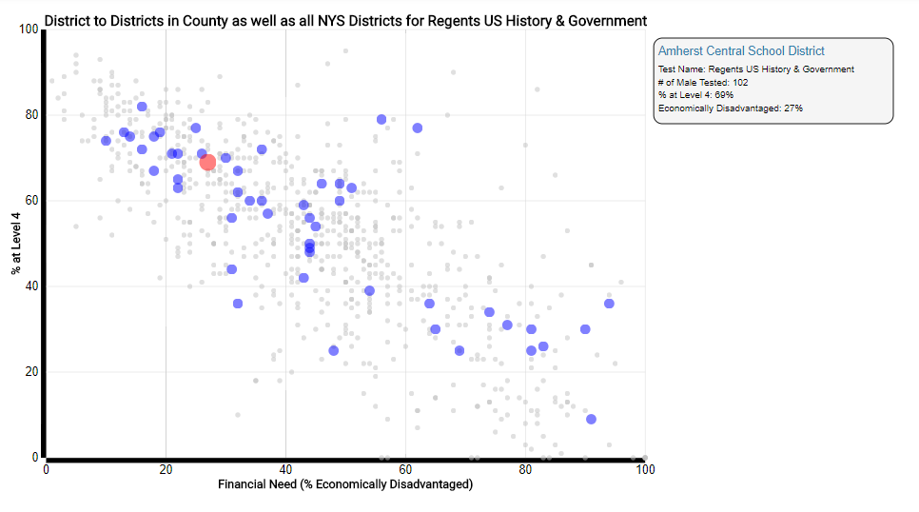
Here is the same cohort with Social Studies.
Regents US History CC 2016-2017.
Notes:
Maybe it is only taking place in ELA and Math. How about Social Studies? There is still a disparity. All – 214/ Females – 112/ Males - 102

Slide 20
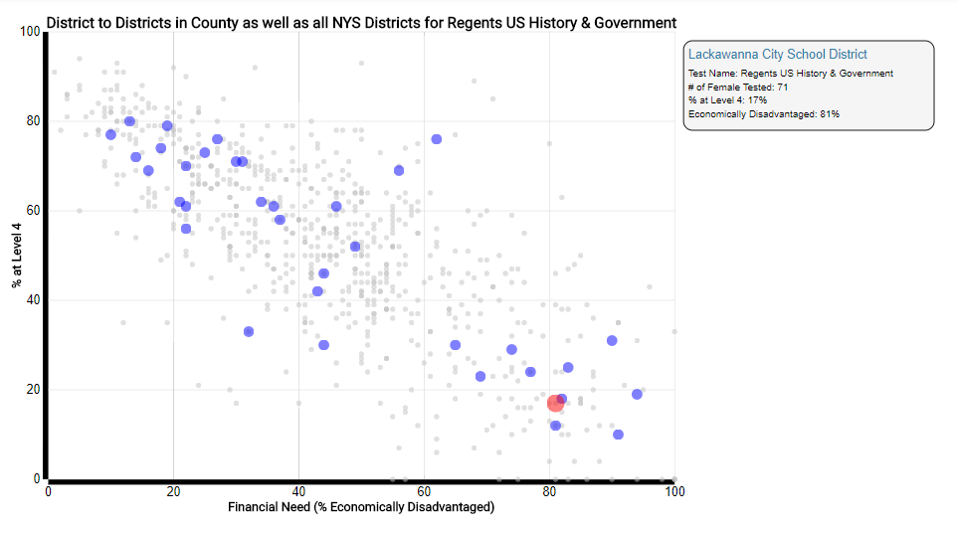
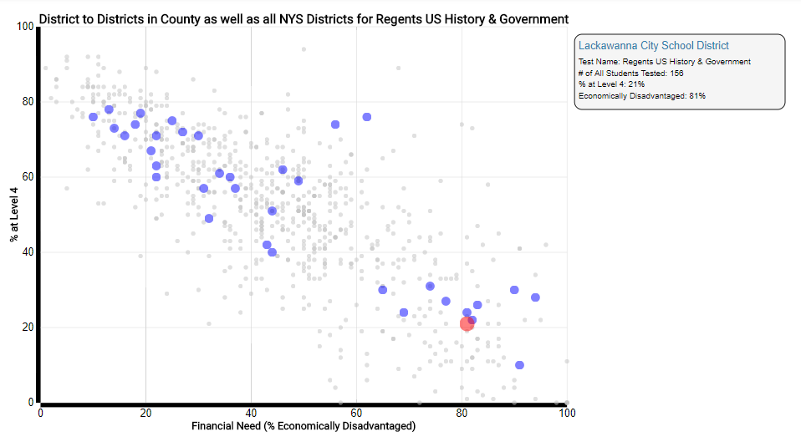
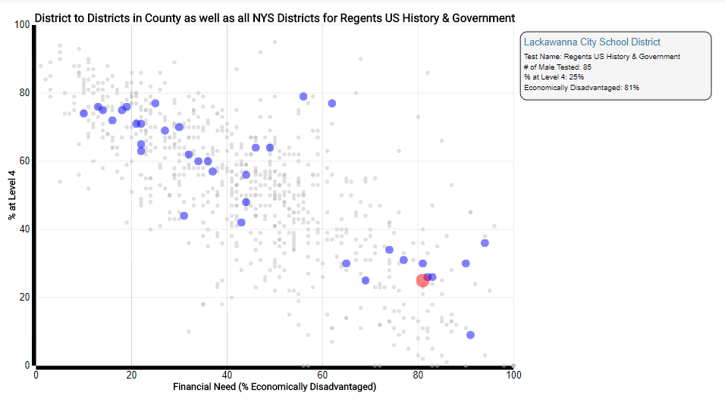
Different District, Different Story.
Regents US History 2016-2017
Notes:
Let’s look at another district. In this district we see a disparity the other way. The boys are outperforming the girls. What could be the cause. What is a major difference? All – 156/ Females – 71/ Males - 85

Slide 21
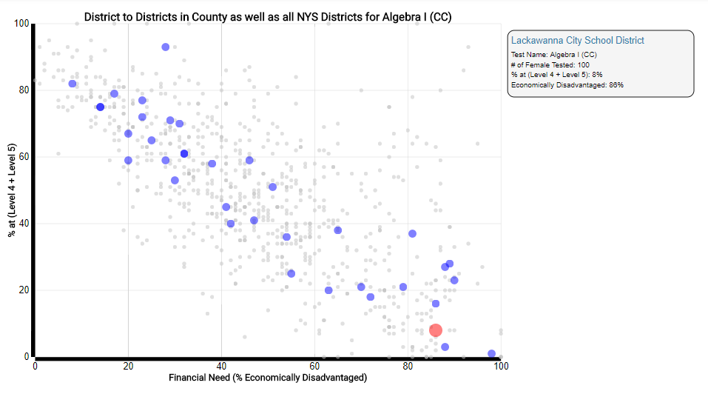
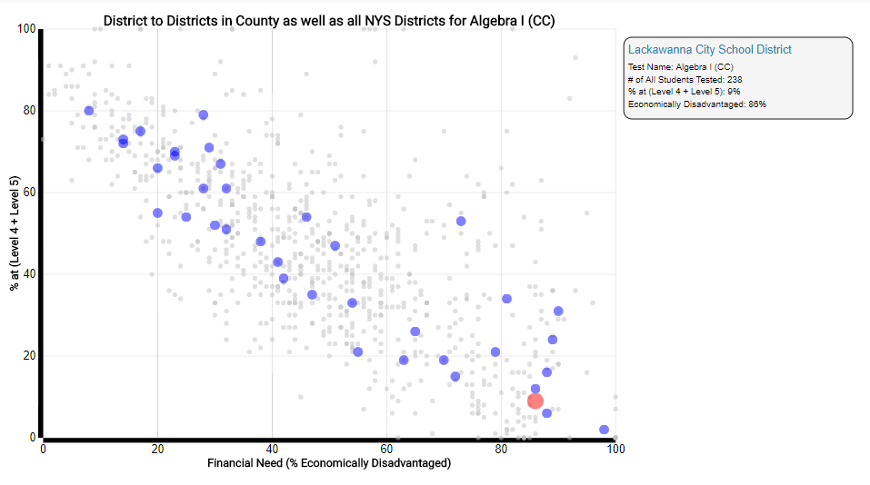
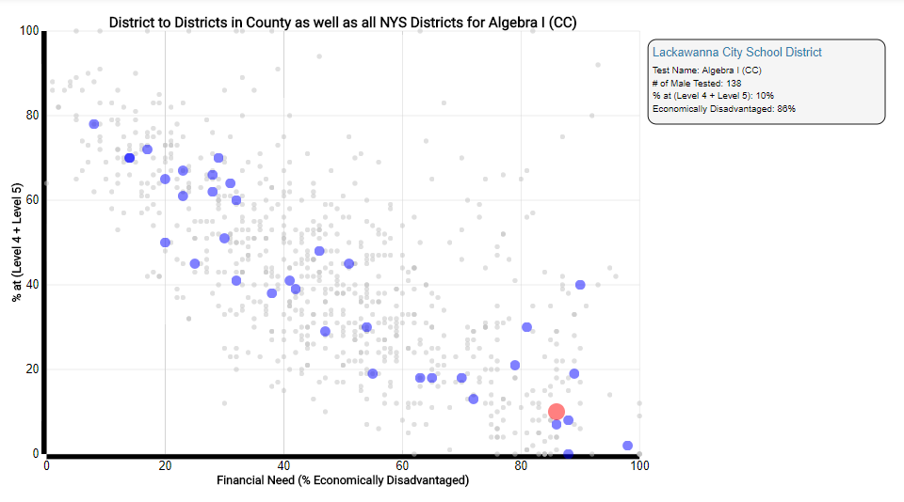
Regents Algebra I CC 2016-2017
Notes:
Does this transfer to other disciplines for this district? These look to close to call. Further digging is needed here. All – 238/ Females – 100/ Males – 138.

Slide 22
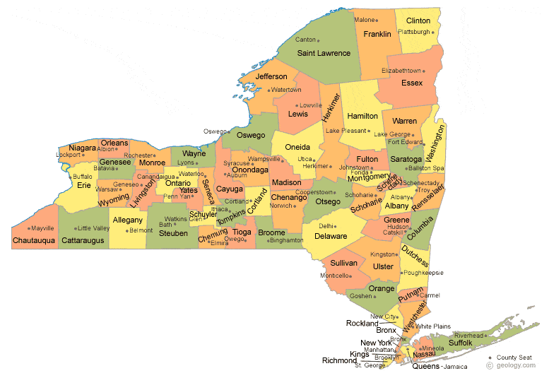
Regional by Counties.
Notes:
We can also make regional comparisons. I picked 6 different counties to make comparisons. My mind thinks West to East.

Slide 23
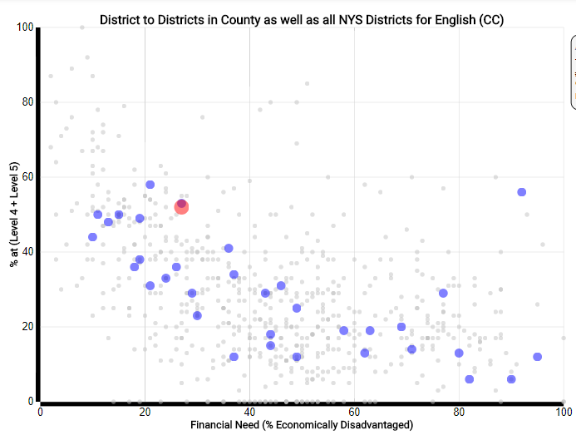
Erie
Monroe
Onondaga
Broome
Albany
Westchester
Students with Disabilities Regents ELA CC
Notes:
Students with Disabilities has been a major area of discussion for us in WNY. Here is a comparison of my six counties. Who do you think shows the best regional performance?

Slide 24
Erie
Monroe
Onondaga
Broome
Albany
Westchester
Regents ELA CC
Notes:
You can do the same thing for subject areas. Here is an ELA example. Is there a comment you can make about Broome county?

Slide 25
Erie
Monroe
Onondaga
Broome
Albany
Westchester
Regents Algebra I CC
Notes:
Here is a Algebra I example. Westchester doesn’t have any in between schools.

Slide 26
Erie
Monroe
Onondaga
Broome
Albany
Westchester
Regents Global History
Notes:
This is a Regents Global History. Onondaga seems to be consistently above the line.

Slide 27
Erie
Monroe
Onondaga
Broome
Albany
Westchester
Regents Earth Science
Notes:
I was a science department chairman. My teachers always thought they were the best. Looks like Erie county is all over the place.

Slide 28
Notes:
This next project is interesting. I tried to find an example of a school that has one of the highest opt out rates and see if I could see if the student performance in secondary ELA exams have dropped off as a result. Here are the charts. These are the Regents Comprehensive Exam results for 2013(613)-2014(580)-2015(481)-2016(45)

Slide 29
Notes:
Here are the results for Regents English CC for 2015(92)-2016(518)-2017(558). What do you think? It might need some more analysis.

Slide 30
What are your ideas?
Notes:
These are my examples. What are your ideas?

Slide 31
How is this done?
Notes:
These are my examples. What are your ideas?

Slide 32
NYS Scatterplots – Public Data https://dataview.wnyric.org/PublicData/ReportCards
Notes:
You can. Here is an example of a scatterplot. The link is public. You don’t need a login. You fill in what you want from the pull down menu. There are many versions of scatterplots you can produce. That is why they can be very effective tools to start discussions. There are other types of scatterplots that display data in this manner.

Slide 33
Snipping tool support
https://support.microsoft.com/en-us/help/13776/windows-use-snipping-tool-to-capture-screenshots
Notes:
These are my examples. What are your ideas?

Slide 34
3 – 8 English Language Arts
Notes:
Here is a 3-8 ELA example. What questions might you have after looking at this data? What are the green dots? How many students are in a cohort? 3rd -240/4th – 283/5th -254/6th -259/7th – 270/8th - 209

Slide 35
3 – 8 Mathematics
Notes:
What happens if I look at the Math for the same group? Why is this valuable? What happened to 8th grade? 3rd -244/4th – 285/5th -258/6th -250/7th – 257/8th - 124

Slide 36
Contact Me
Timothy W. Johnson
Professional Developer
Administration & Supervision Erie 1 BOCES/WNYRIC 355 Harlem Road
West Seneca, NY 14224-1892
office (716) 821-7227/fax (716) 821-7498/cell (716) 429-5876
tjohnson@e1b.org

